Slide 1
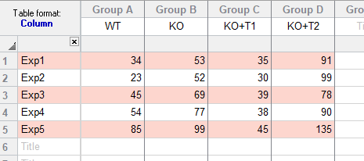
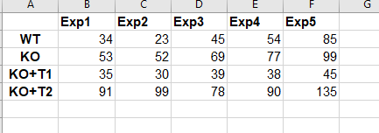
Just pivoting
Excel
Prism

Slide 2
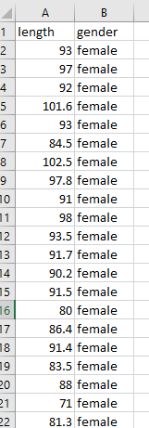
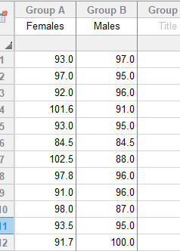
Long format to wide format (=Prism format): example with 2 levels
Prism
Excel

Slide 3
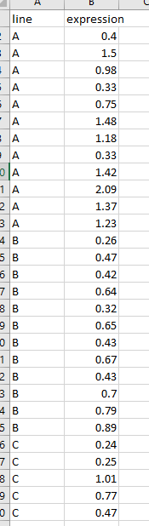
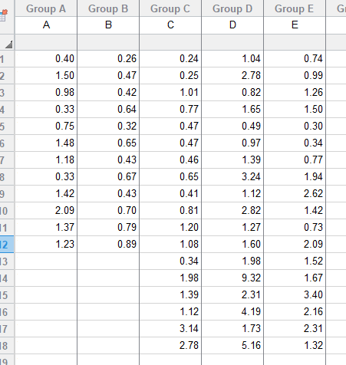
Long format to wide format (=Prism format): example with more than 2 levels
Prism
Excel

Slide 4
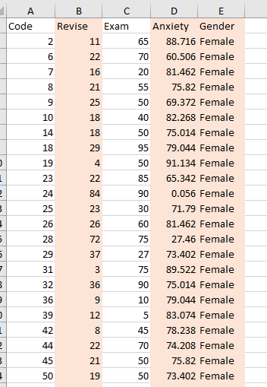
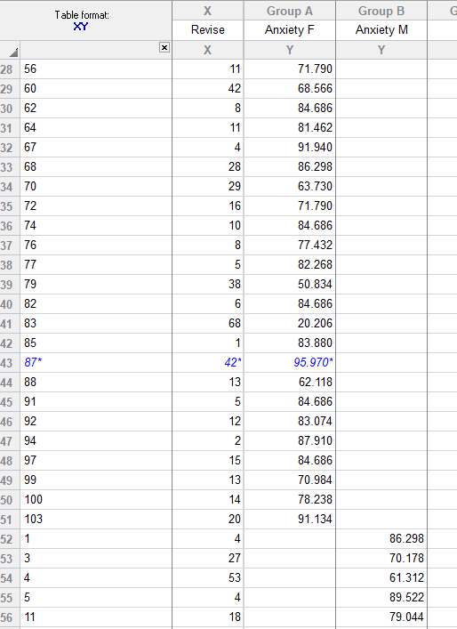
Long format to bizarre format (=Prism format)
2 predictors: Revise (continuous, in X) and Gender (binary, split into 2 columns Group A and B) – could be more than 2 levels
Prism
Excel

